Slide 1

Deluge
By: Abdalrhman Mostafa
Notes:
https://deluge.zoho.com/

Slide 2
Deluge Tutorial
How it works?
info <expression>; // for printing
<variable_name> = <expression>; // declare and initialize
Data types , operators , comments , expressions and concat.

Slide 3
If condition
if ( <condition> )
{
// Executes if condition is true
<statements>
}
else if ( <condition2> )
{
// Executes if condition2 is true , could be multiple of else if
<statements>
}
else
{
// Executes if condition is false
<statements>
}
Note : CONDITION LIKE -> <variable> < operator> <expression> , could use && and || between conditions

Slide 4
List
<variable> = List();
<variable> = {}; //put comma separated values
<variable>.add( <expression> );
<variable>.remove(<Index NUMBER>);
<variable>.removeElement(<expression>);
<variable>.get(<Index NUMBER>);
List is a collection variable which holds a collection of data based on index. Insertion and retrieve values are based on index. Index starts from 0.
Insertion order will be maintained, and values will not be sorted by default. Duplicate values are allowed to be inserted.

Slide 5
Loop
for each <variable> in <List>
{
// executes for each element
<statements>
}
Unfortunately, there isn’t normal for loop neither while loop in deluge.
Could use continue and break inside but don’t use comments next to them

Slide 6
Map
<variable> = Map();
<variable> = {<key>: <value>, <key>: "<value>"}
<variable>.put(<key>, <value>);
<variable>.remove( <key> );
Map is a collection variable which stores collection of data as a key-value pair.
Insertion order will be maintained & on adding value to the existing key will replace the value.
Notes:
Try coding https://deluge.zoho.com/tryout

Slide 7
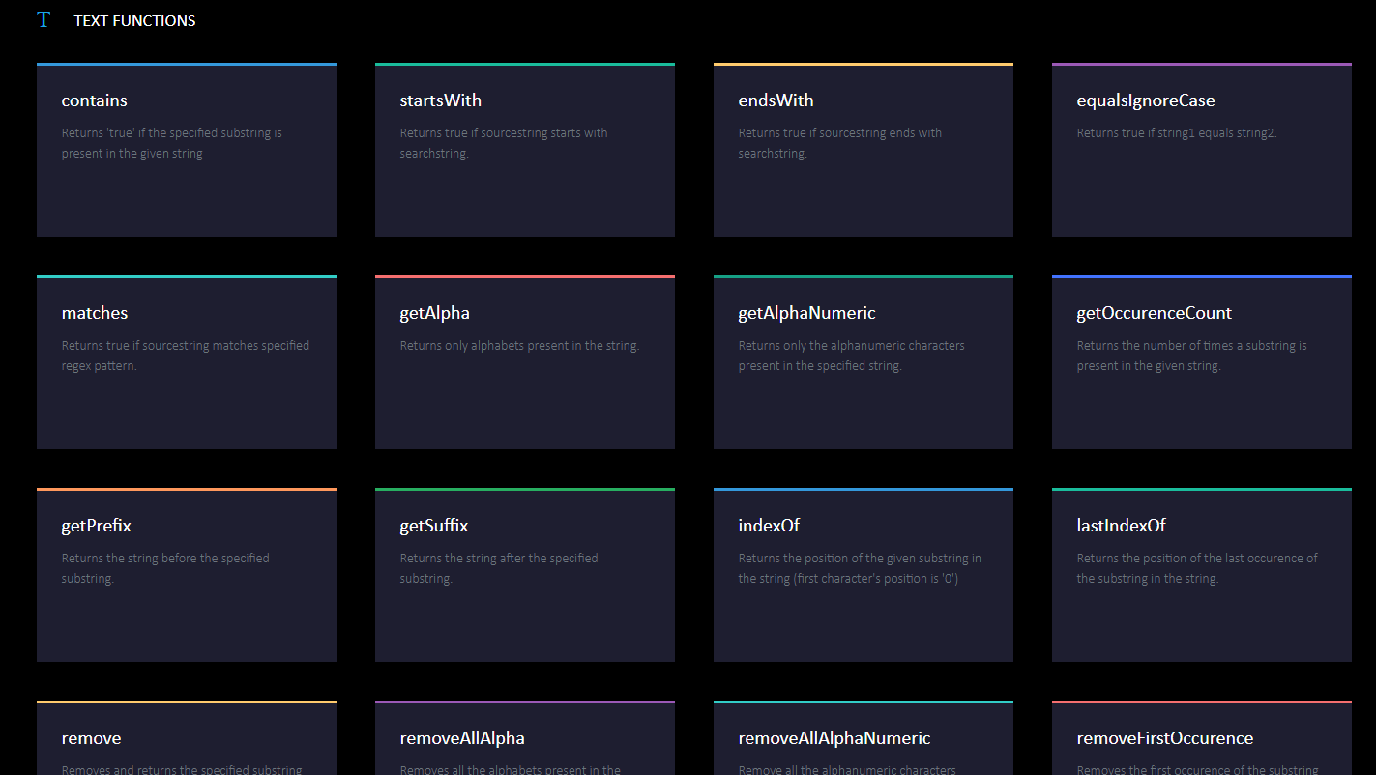
Notes:
https://deluge.zoho.com/help/

Slide 8
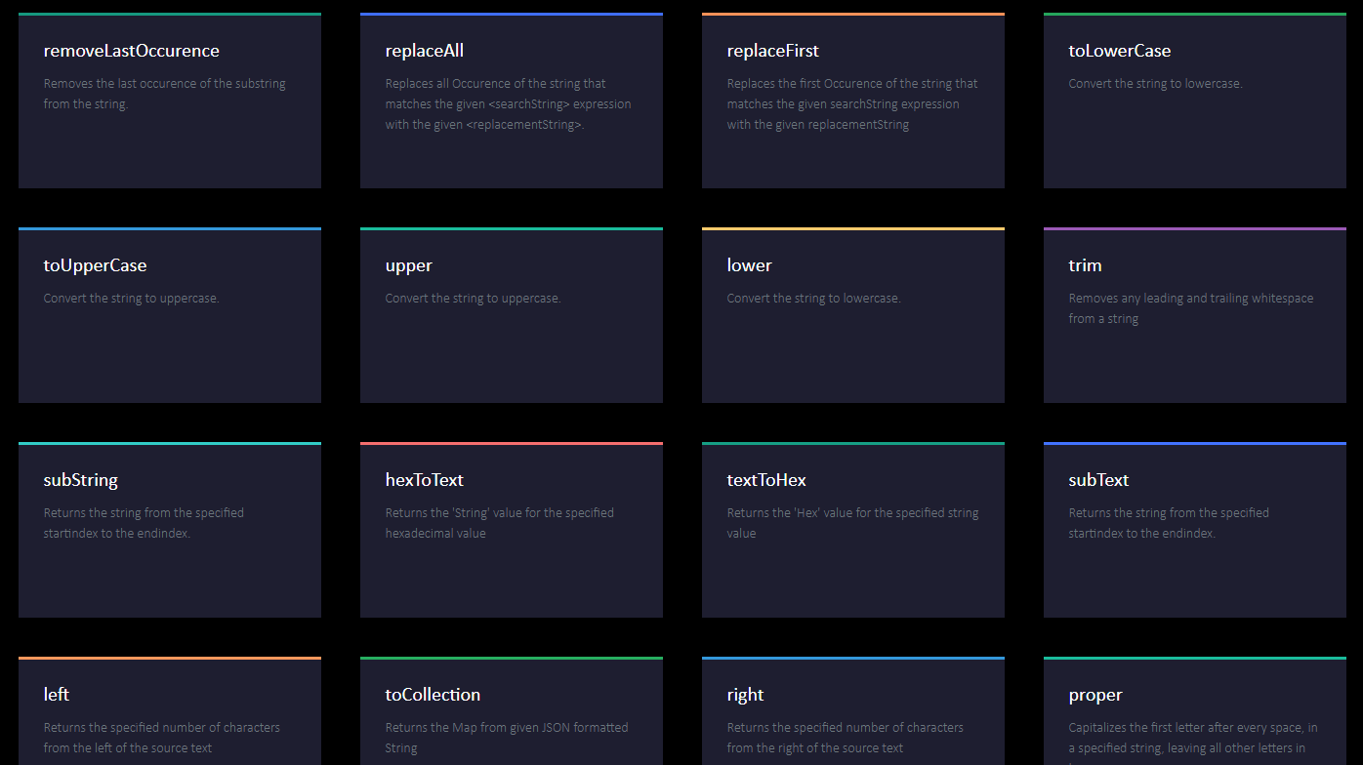

Slide 9
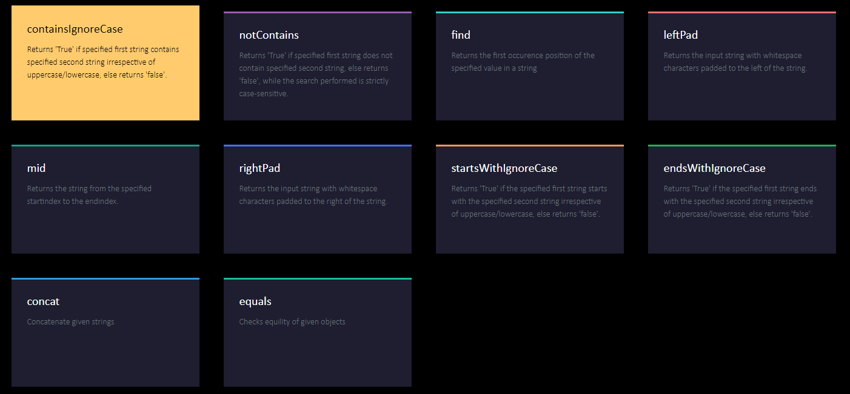

Slide 10
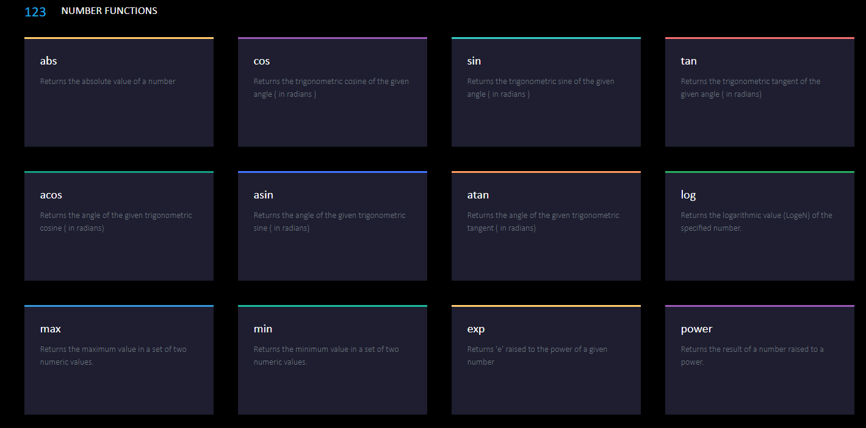

Slide 11
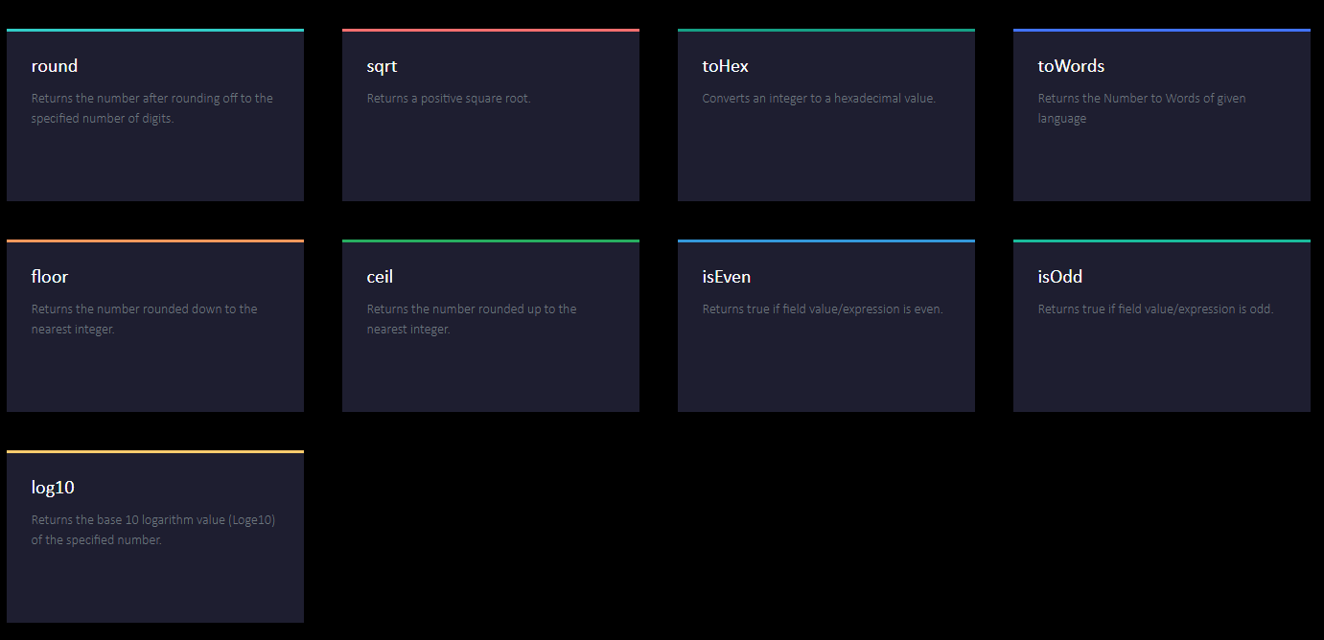
Notes:
See more at site.

Slide 12
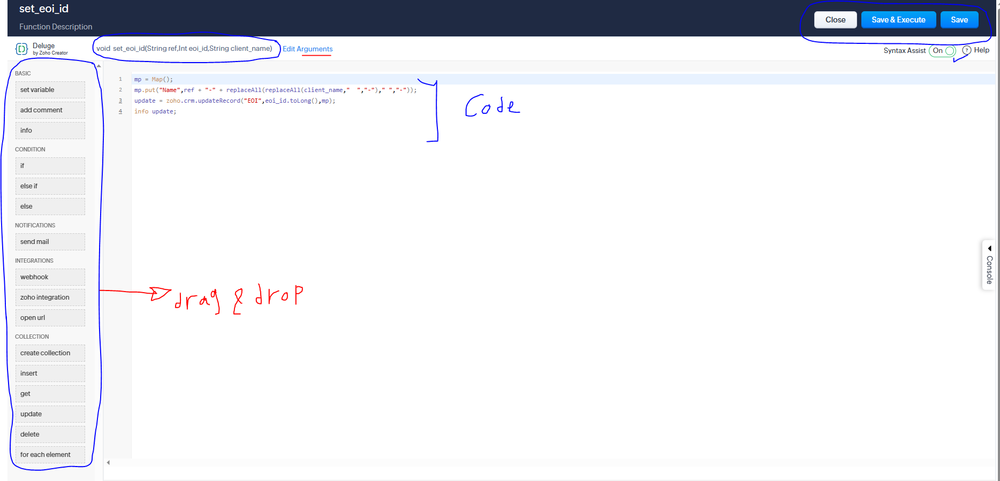
Drag and drop , Interfaces
Note: Not all zoho platforms has arguments and functions like zoho creator doesn’t have function argument.
Can’t call a function inside the function.
Note: Not all Syntax are available in all zoho platforms , like hide is only available for zoho creator.
Note: You can execute to see results before closing and you can send results to your mail for testing , also you can send mails by the code if needed.
Use # in argument’s value to access module field and map it.

Slide 13
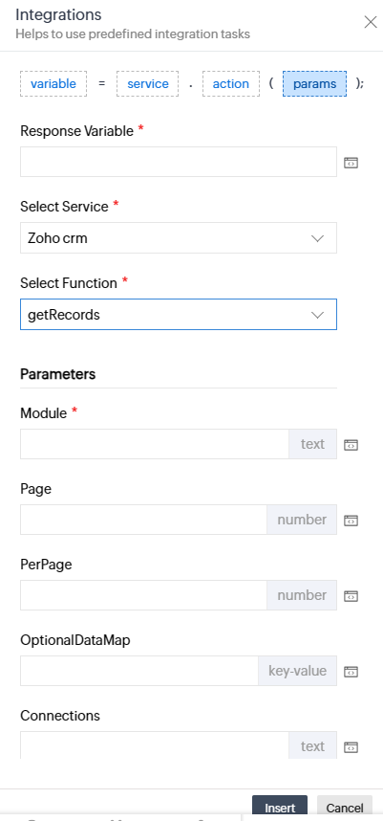
Cont.
response = zoho.crm.getRecords (“Module”, 0, 200,conn);
response = zoho.crm.updateRecord(“Module”, id, dataMap, conn);
response = zoho.crm.getRecordById(“Module”, id, conn);
Note: see documents for each zoho integration function and platform.
Send Mails:
sendmail
[
from: zoho.loginuserid / : zohoadminuserid
to: <expression>
subject: <expression>
message: <expression>
attachments:<component> <name> as PDF
]

Slide 14
Libraries
res = num.toWords("en-us");
response = zoho.ai.translate(res, "ar"); // translation library
result = response.getJSON("translation").getJSON("translate");
zoho.currentdate; // returns current date
Note: Zoho has it’s own libraries and there are a lot of them.

Slide 15
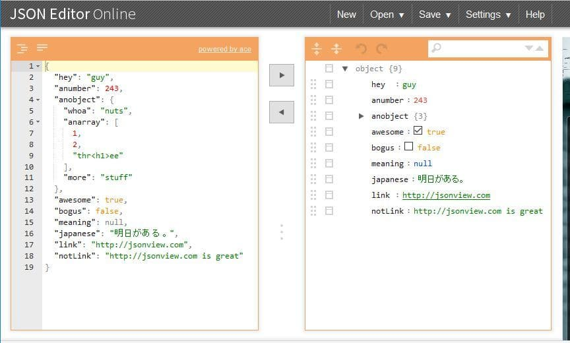
JSON
Get JSON response and to get specific data use getJson() as previous example
Note , fields named in zoho with the linked name filed or Api name.
Could be a list inside a list.
Notes:
Online JSON Viewer (stack.hu)
codebeautify.org
JSON Editor Online: JSON editor, JSON formatter, query JSON
JSON Viewer - JSON Hero
JSON Viewer - Free Tool to View and Edit JSON Code Online (jsononline.net)
ejson.io/Tools/jsonviewer/

Slide 16






Application Programming Interface (APIs)

Slide 17
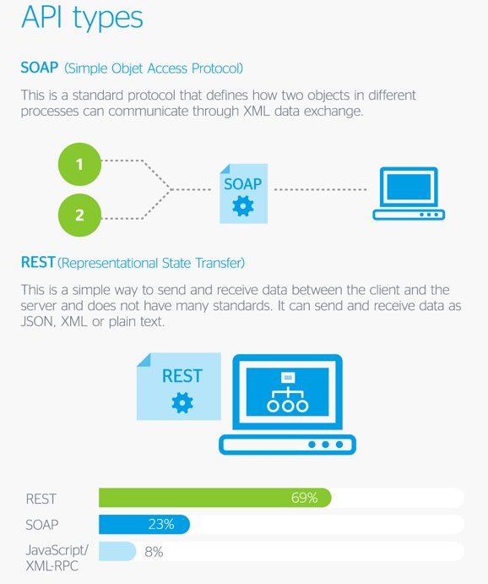

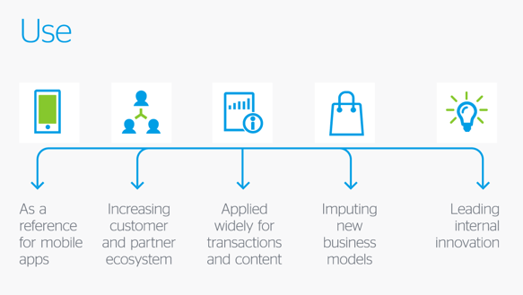
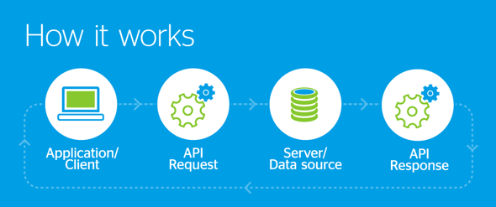
Cont.
Notes:
Browse all - Free APIs (free-apis.github.io)
Free API - Huge List of Public APIs For Testing [No Key] – Apipheny
API Hub - Free Public & Open Rest APIs | Rapid (rapidapi.com)
https://github.com/public-apis/public-apis

Slide 18
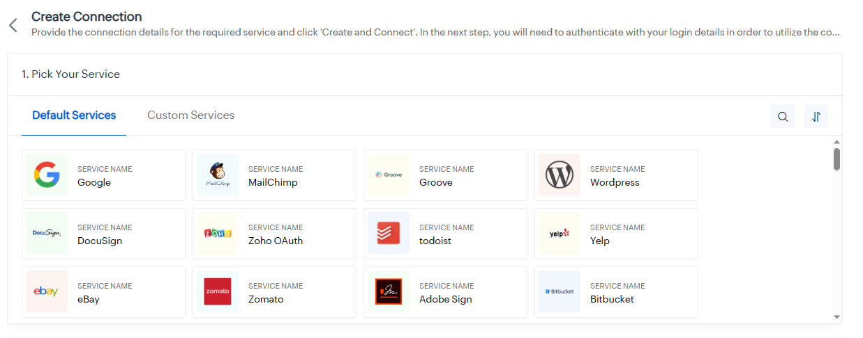
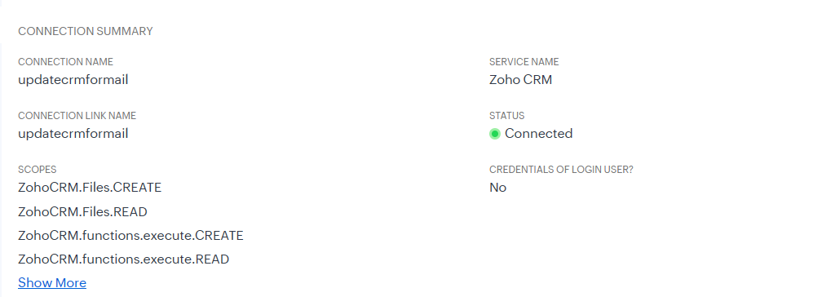
Invoke Url , Connection
response = invokeUrl [
url: <api_url>
type: GET/POST/PUT/DELETE
parameters: <paramMap/string> //filter criteria
connection: “connection_name"
];

Slide 19
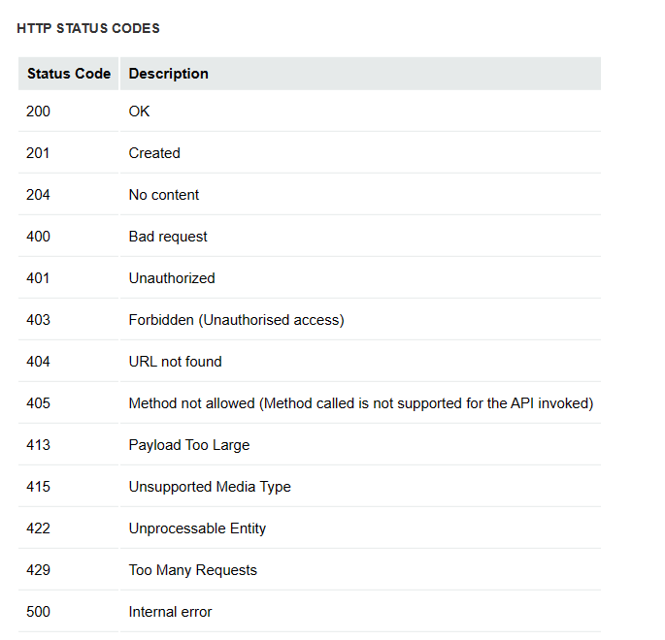
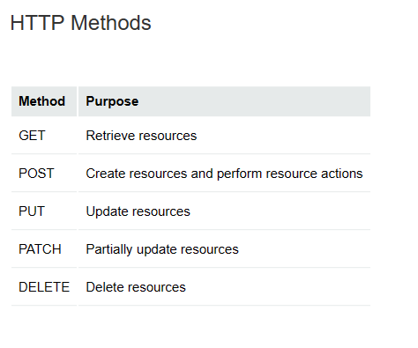
Cont.
HTTP Request
Notes:
Response Structure - APIs | Online Help - Zoho CRM : https://www.zoho.com/crm/developer/docs/api/v2/response-structure.html

Slide 20
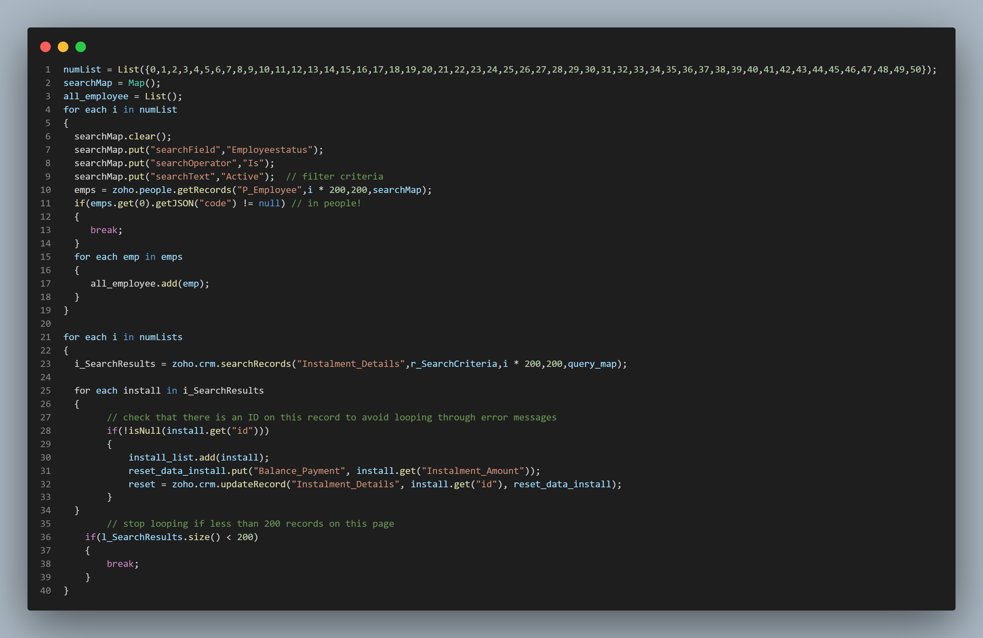
Sample code and Tips

Slide 21
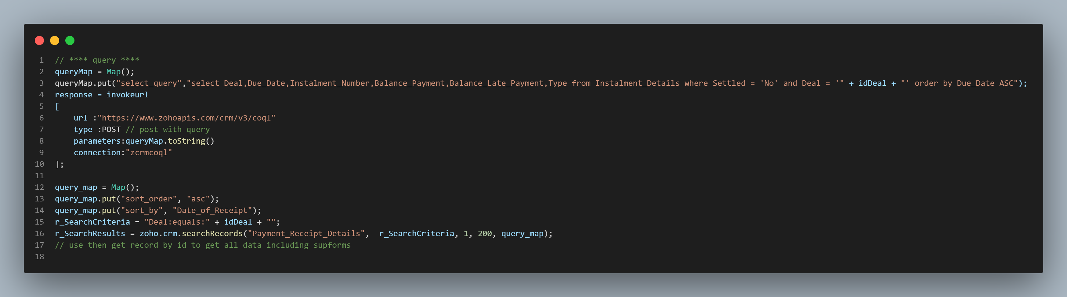
Cont.

Slide 22
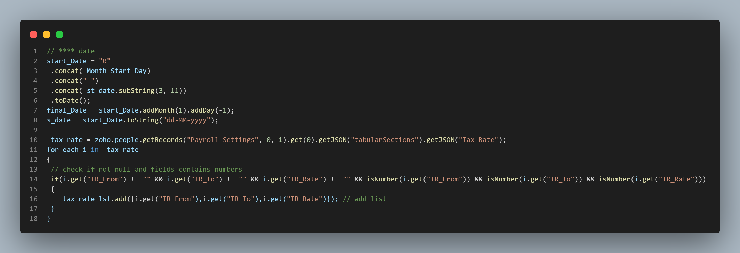
Cont.

Slide 23
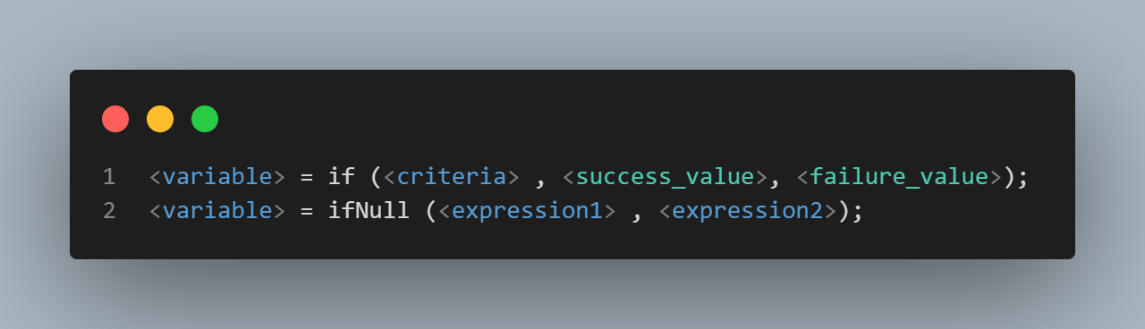
Cont.
Notes:
Ternary Operator

Slide 24
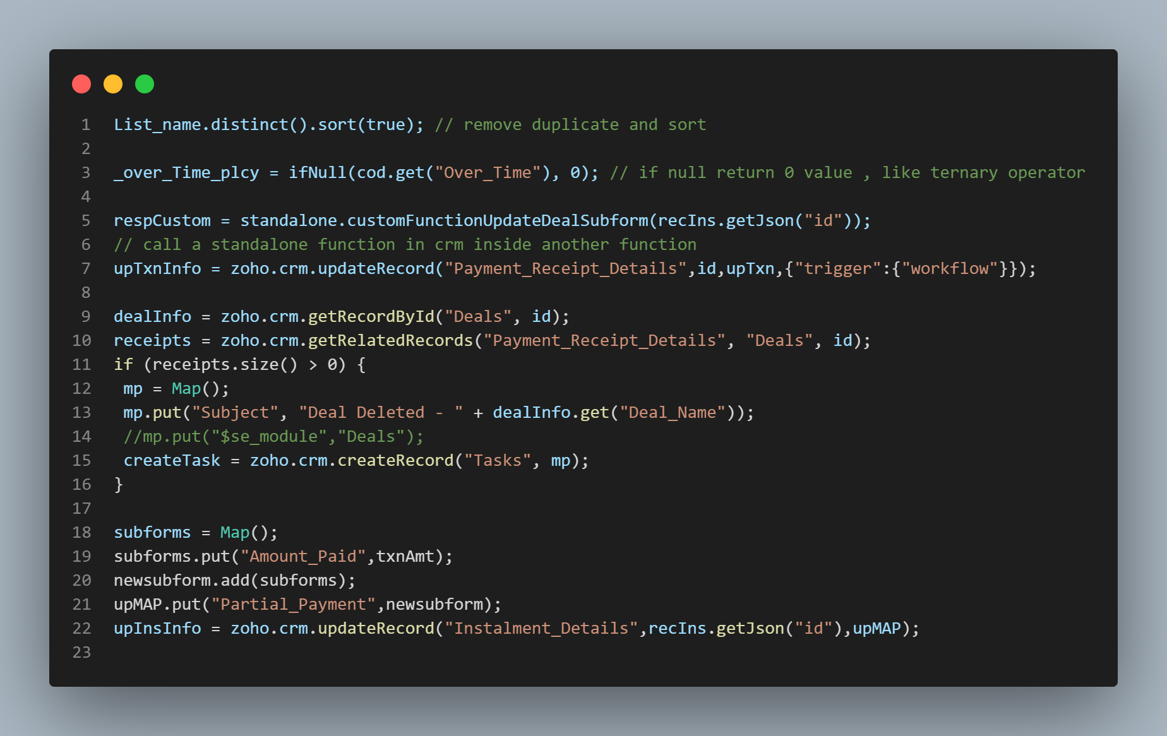
Cont.

Slide 25
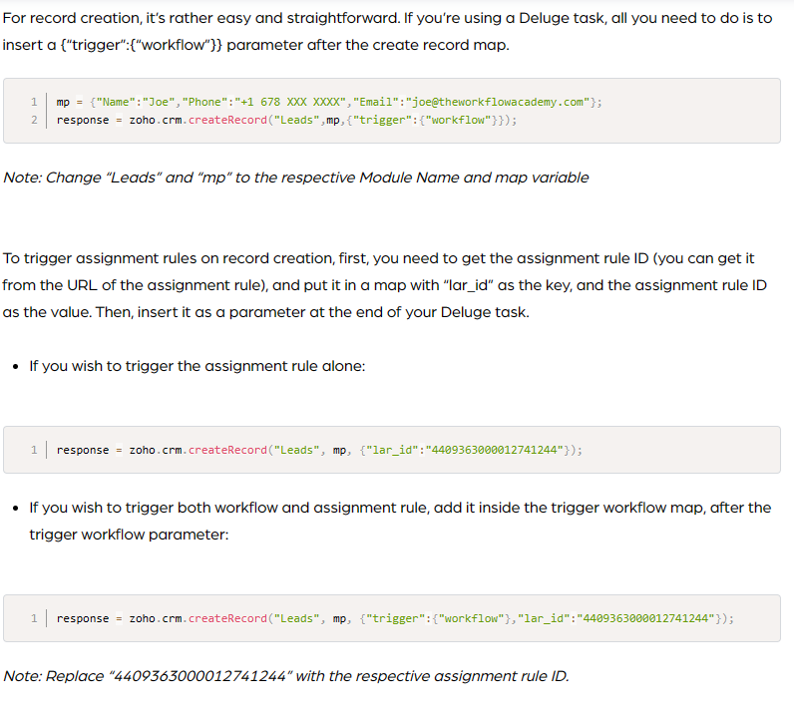
Cont.

Slide 26
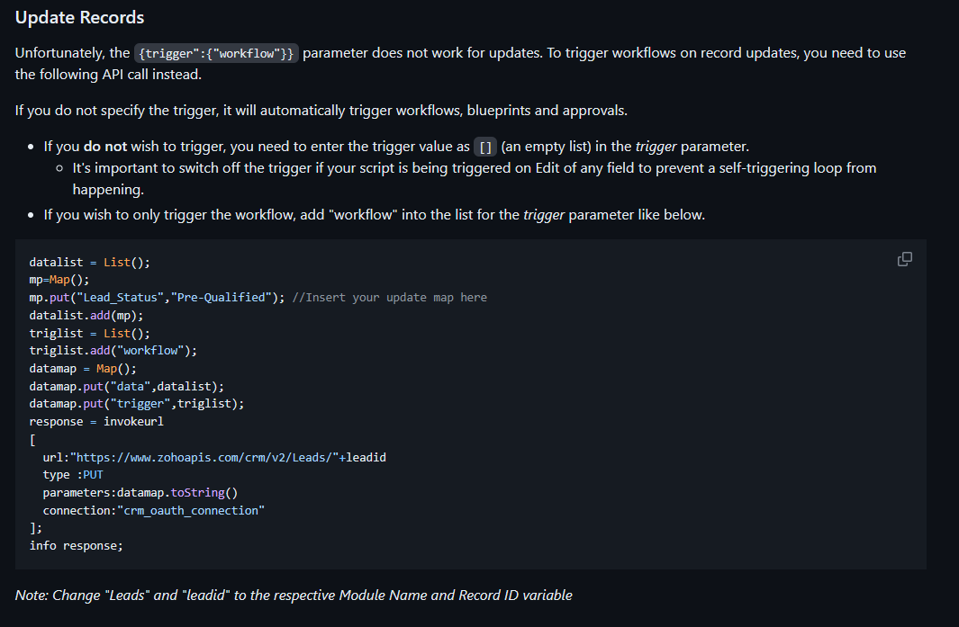
Cont.

Slide 27
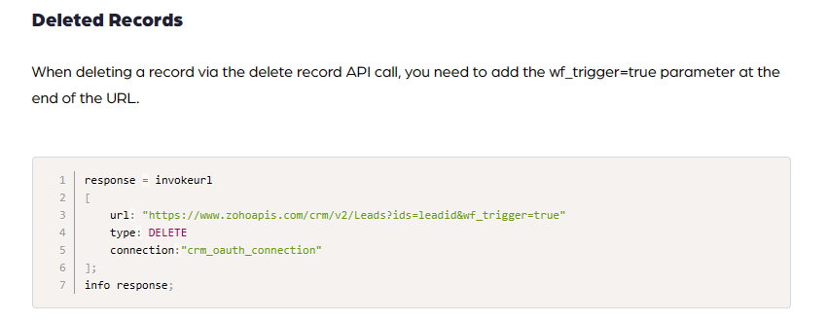
Cont.
Notes:
Ids could be list of ids

Slide 28
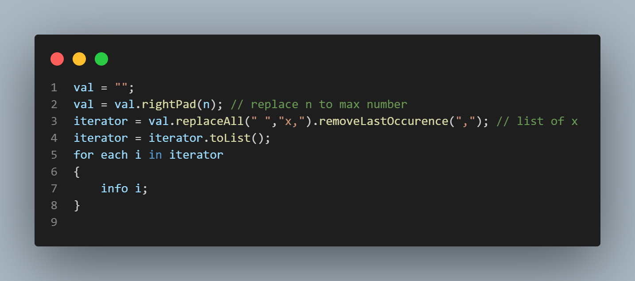
Create Numlist for looping

Slide 29
creator
Inserting
HTML Snippet
Subforms

Slide 30
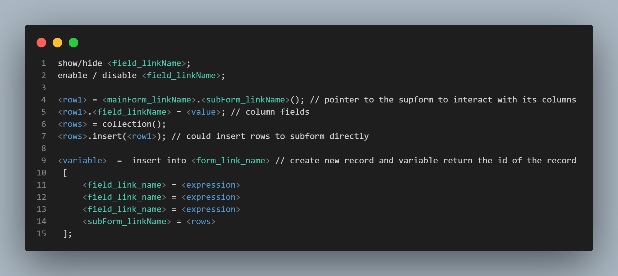
Inserting

Slide 31
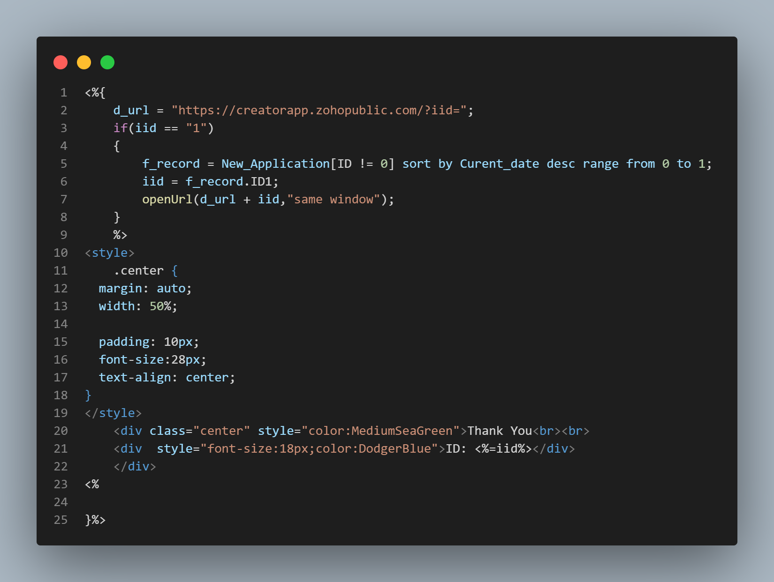
HTML Snippet
<%{the whole code (Deluge/ HTML)}%>
<%= Deluge Variable%>
ex: <p class = "lesson_status"><%=lesson_status%></p>
%>Deluge Code lines%>
Could separate brackets by putting HTML inside

Slide 32
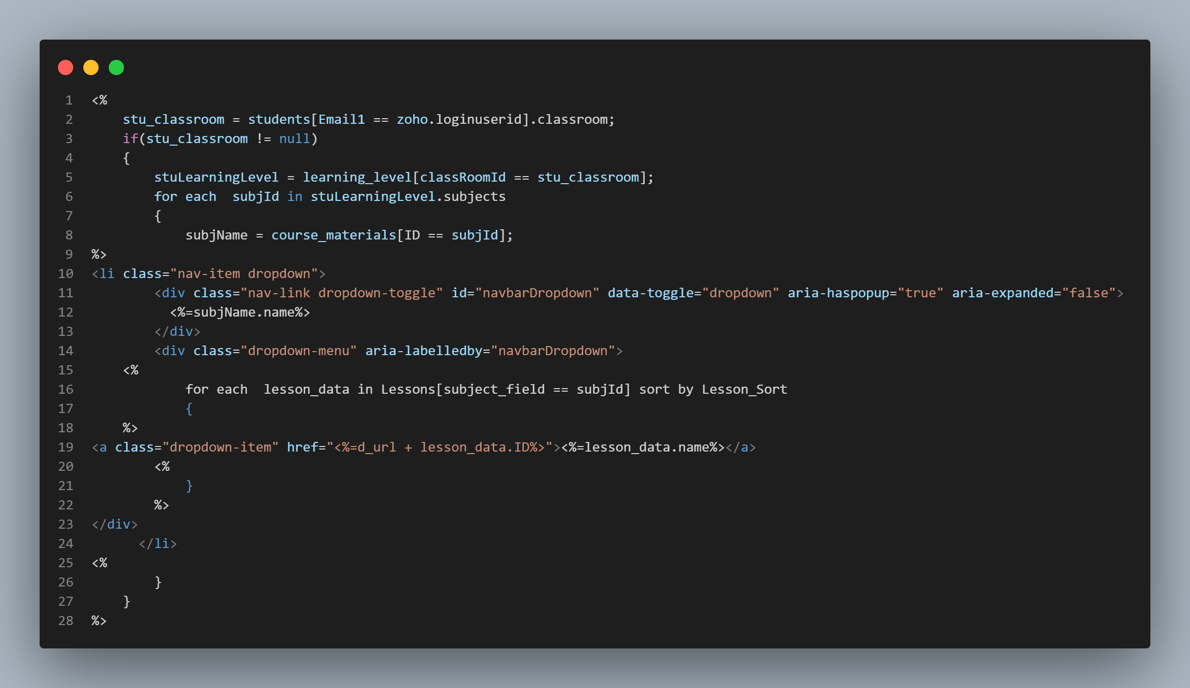
Cont.

Slide 33
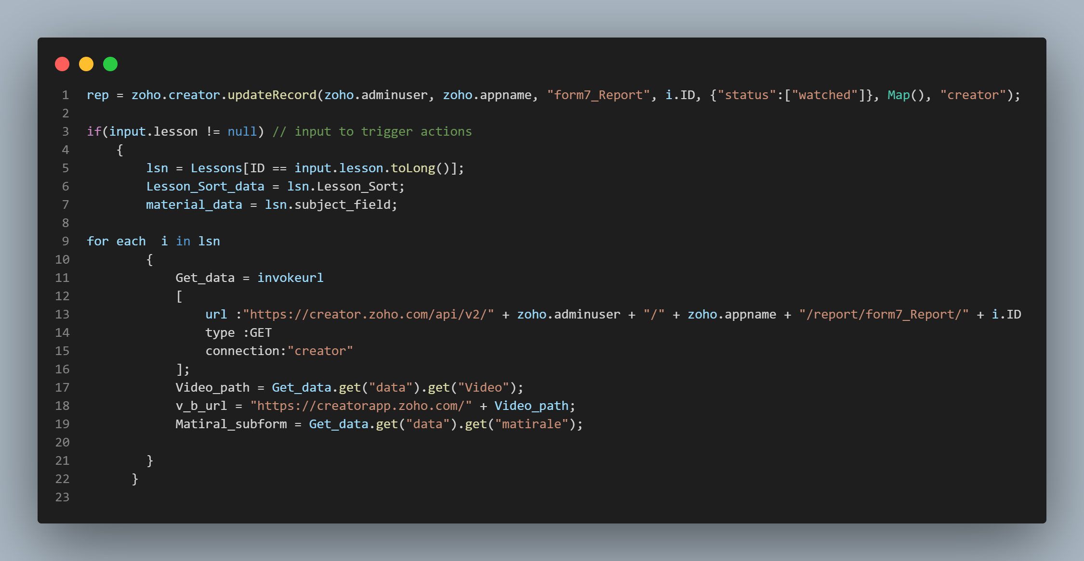
Cont.

Slide 34
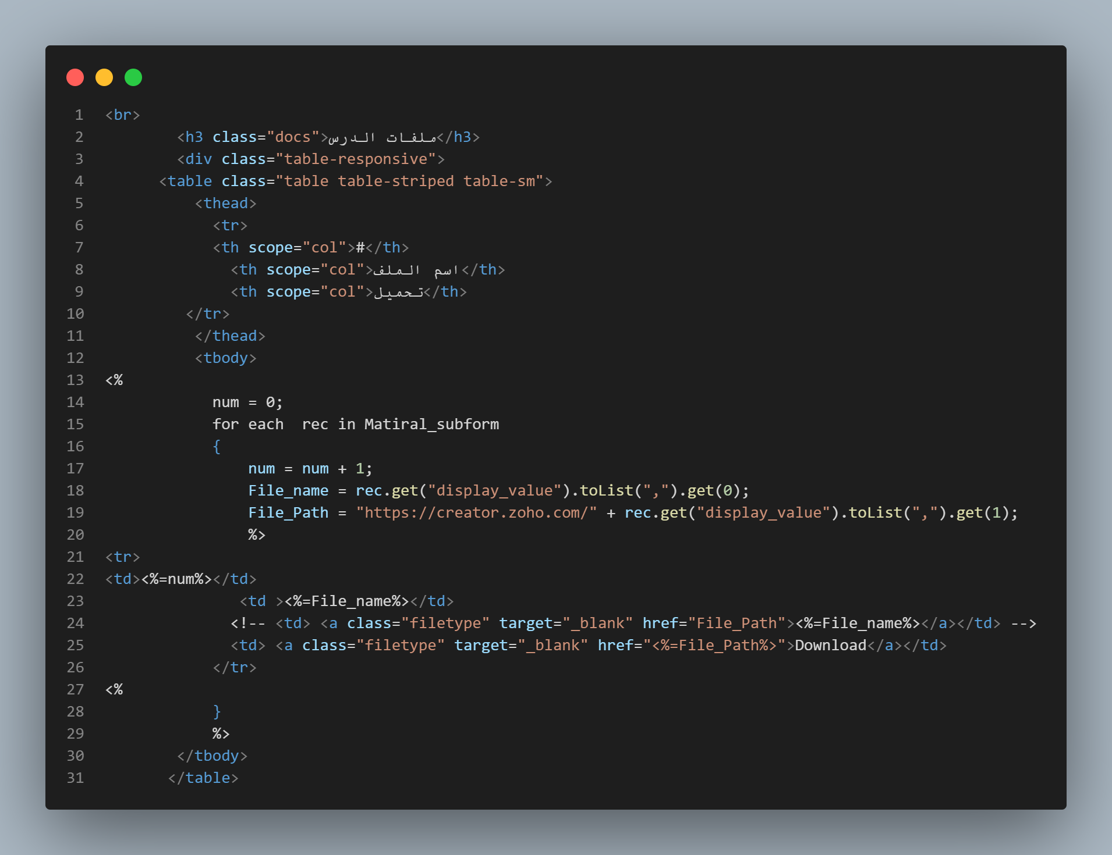
Subforums

Slide 35
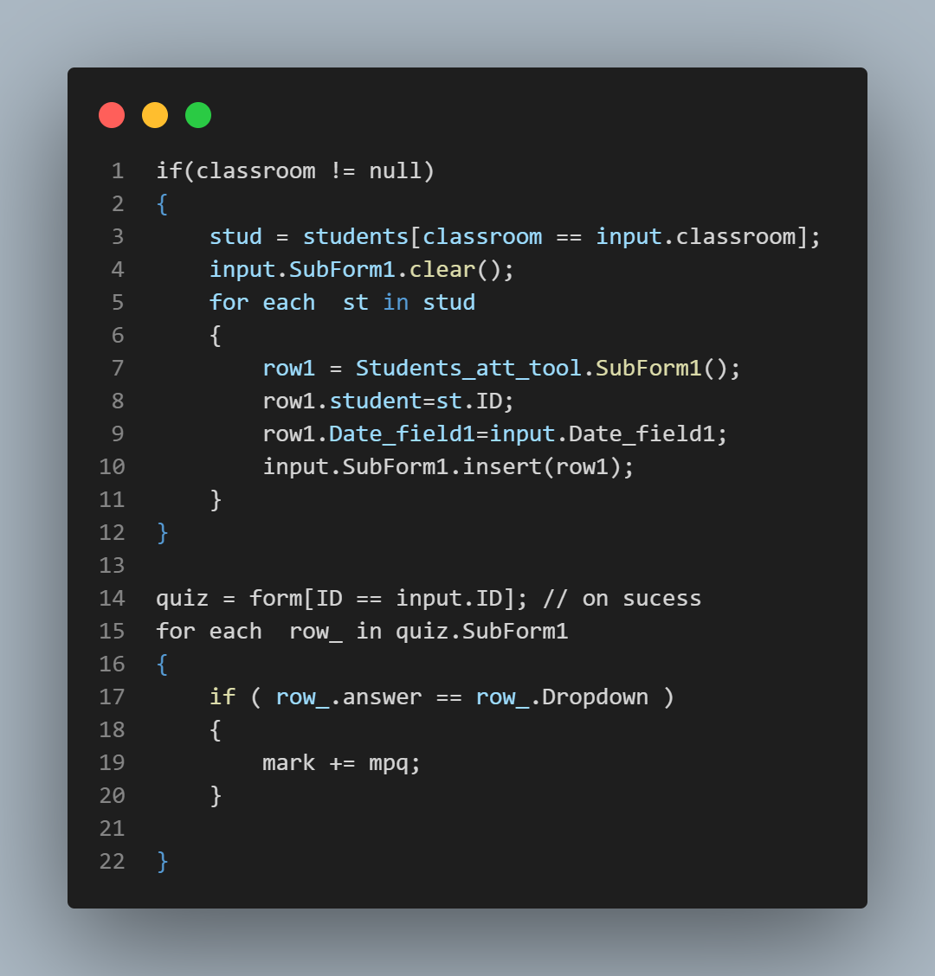
Example
Notes:
Add records | Help - Zoho Deluge https://www.zoho.com/deluge/help/data-access/add-record.html
access subForm fields | Help - Zoho Deluge https://www.zoho.com/deluge/help/miscellaneous/access-subform-fields.html

Slide 36
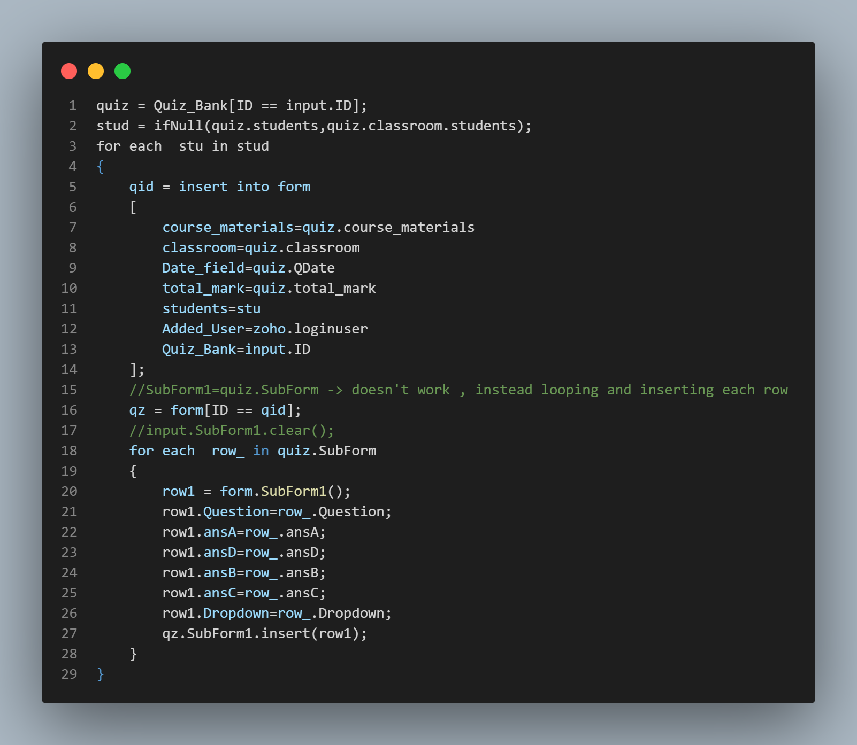
Example

Slide 37
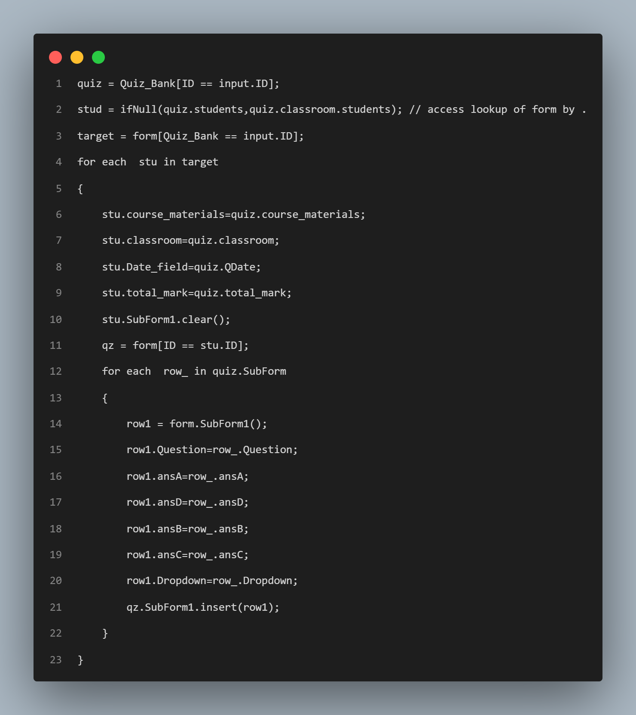
Example 2

